Slide 1



ACHIEVERS CONSULTANCY
“Where Your Education Meets Your Ambition !!!”
Presented by
Jagadeeswari Sambangi
Amruthavarshini Sadineni
Vineeth Petnakota
Devanshi Patel

Slide 2



Agenda
Introduction
Timeline
ERD Diagram
Queries/
Commands
Business Objectives
&
Business Rules
2

Slide 3

Introduction
Consultancy can be extremely useful to students who wish to study abroad. Study abroad consultants can provide valuable guidance and support throughout the entire process, from selecting the right country and university to applying for scholarships and visas. And for that we are the helping students to achieve their dreams and make their path little easy.
3

Slide 4
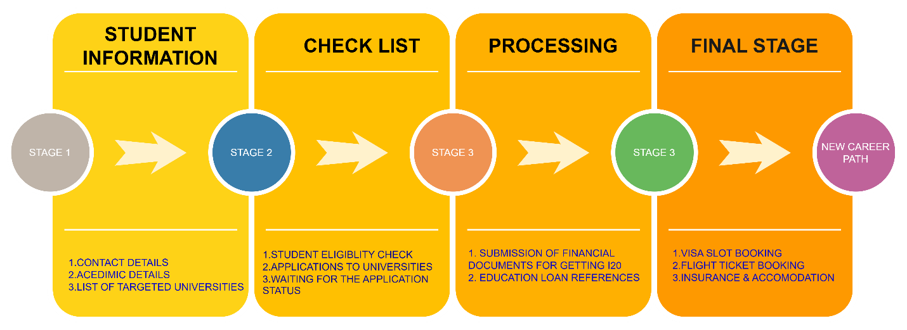
TIMELINE
NOTE:Every Deck of FALL/SPRING/SUMMER -INTAKES the process will be same.
4

Slide 5


Consultancies can specialize in management, finance, technology, human resources, marketing, and other disciplines to help students who want to expand their careers across and arrange for them to join certain institutions. Additionally, they might offer a range of services. Mostly for students who desire to travel the world and work with multinational corporations after high school, as well as for those who wish to study abroad or get assistance.
Business
Objective
&
Business Rules
Students' data must be kept private, and the personnel must be knowledgeable about all of the steps depicted in the figure. Students should be able to select their favourite courses and universities.
Universities should collaborate with accredited universities to persuade students not to attend Blacklist colleges. Students can select their favourite Agents to assist them during the process.
5

Slide 6
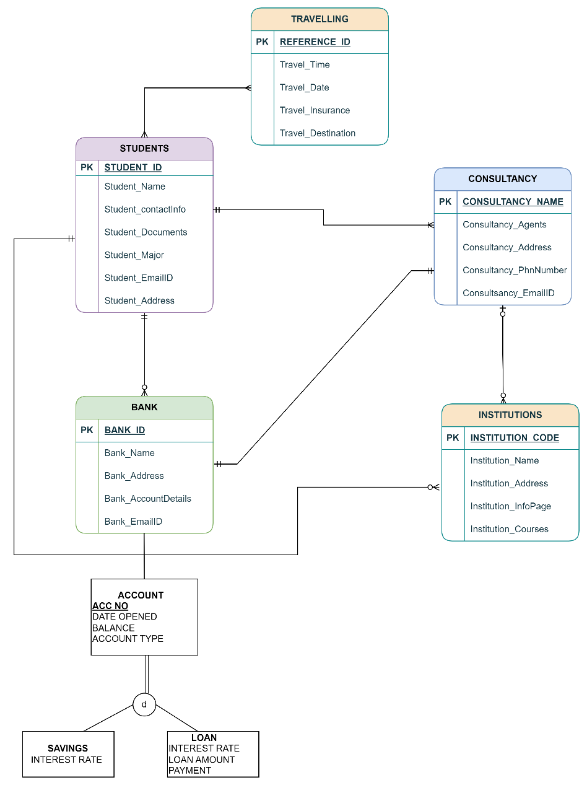
ERD DIAGRAM
6
6

Slide 7
Queries
Creation of Tables
STUDENT TABLE
CREATE TABLE student (
s_id INT PRIMARY KEY,
s_name VARCHAR(50),
s_info VARCHAR(50),
s_doc INT,
s_major VARCHAR(50),
s_eid VARCHAR(50),
s_add VARCHAR(100)
);
BANK TABLE
CREATE TABLE bank (
bank_id INT PRIMARY KEY,
bank_name VARCHAR(50),
bank_add VARCHAR(100),
bank_det INT,
bank_eid VARCHAR(50),
s_id INT,
FOREIGN KEY (s_id) REFERENCES student(s_id)
);
7

Slide 8
INSTITUTION TABLE
CREATE TABLE institution (
ins_code INT PRIMARY KEY,
ins_name VARCHAR(50),
ins_infopage VARCHAR(100),
ins_courses VARCHAR(100),
s_id INT,
bank_id INT,
FOREIGN KEY (s_id) REFERENCES student(s_id),
FOREIGN KEY (bank_id) REFERENCES bank(bank_id)
);
TRAVEL TABLE
CREATE TABLE travel (
ref_id INT PRIMARY KEY,
t_date DATE,
t_insu VARCHAR(50),
t_dest VARCHAR(50),
s_doc INT,
s_id INT,
bank_id INT,
FOREIGN KEY (s_id) REFERENCES student(s_id),
FOREIGN KEY (bank_id) REFERENCES bank(bank_id)
);
8

Slide 9
CONSULTANCY TABLE
CREATE TABLE consultancy (
c_name_id INT PRIMARY KEY,
c_det INT,
c_agent VARCHAR(50),
c_cont_info VARCHAR(50),
c_eid VARCHAR(50),
s_id INT,
ins_code INT,
FOREIGN KEY (s_id) REFERENCES student(s_id),
FOREIGN KEY (ins_code) REFERENCES institution(ins_code)
);
describe student;
describe travel;
describe bank;
describe institution;
describe consultancy;
9

Slide 10
INSERT DATA INTO STUDENT TABLE
INSERT INTO student (s_id, s_name, s_info, s_doc, s_major, s_eid, s_add)
VALUES (1001, 'Jagadeeswari', 'Grad Student', 20, 'IS', 'hd76292@umbc.edu', '123 Main Street, Anytown, USA');
INSERT INTO student (s_id, s_name, s_info, s_doc, s_major, s_eid, s_add)
VALUES (1002, 'Vineeth', 'Senior', 30, 'BA', 'rx82617@umbc.edu', '456 High Street, Anytown, USA');
10

Slide 11
INSERT DATA INTO BANK TABLE
INSERT INTO bank (bank_id, bank_name, bank_add, bank_det, bank_eid, s_id)
VALUES (101, 'ABC Bank', '789 Oak Street, Anytown, USA', 301, 'abcbank@xyz.com', 1001);
INSERT INTO bank (bank_id, bank_name, bank_add, bank_det, bank_eid, s_id)
VALUES (102, 'EFG Bank', '700 Oak Street, Anytown, USA', 302, 'efgbank@xyz.com', 1002);
INSERT DATA INTO CONSULTANCY TABLE
INSERT INTO consultancy (c_name_id, c_det, c_agent, c_cont_info, c_eid, s_id, ins_code)
VALUES (1, 301, 'ABC Agency', 'abcagency@email.com', 'abcagency@xyz.com', 1001,1);
11

Slide 12
INSERT DATA INTO INSTUTUTION TABLE
INSERT INTO institution (ins_code, ins_name, ins_infopage, ins_courses, s_id, bank_id)
VALUES (1, 'UMBC', 'https://umbc.edu', 'Information Systems', 1001, 101);
INSERT INTO institution (ins_code, ins_name, ins_infopage, ins_courses, s_id, bank_id)
VALUES (2, 'UMBC', 'https://umbc.edu', 'Information Systems', 1002, 102);
INSERT DATA INTO TRAVEL TABLE
INSERT INTO travel (ref_id, t_date, t_insu, t_dest, s_doc, s_id, bank_id)
VALUES (10001, date '2023-06-06', 'TravelSafe', 'Baltimore', 20, 1001, 101);
12

Slide 13
SELECT QUERY
select * from student;
select * from consultancy;
select * from bank;
select * from travel;
select s_id,s_name from student;
select bank_id, bank_name from bank;
select * from student
where s_id=1001;
select * from student
where s_info='Grad Student' and s_major='IS';
13

Slide 14
UPDATE QUERY
UPDATE STUDENT “AMRUTHA” DATA WITH STUDENT “JAGADEESWARI” NAME
update student
set s_name='Amrutha'
where s_id=1001;
select * from student;
UPDATE STUDENT “VINEETH” DATA WITH STUDENT “DEVANSHI” NAME
update student
set s_name='Devanshi',s_major='CS'
where s_major='BA';
select * from student;
14

Slide 15
JOIN QUERY
JOIN: INNER JOIN & LEFT JOIN
SELECT ins_name, s_name, c_agent
FROM institution
INNER JOIN student ON institution.s_id = student.s_id
INNER JOIN consultancy ON student.s_id = consultancy.s_id;
SELECT s.s_name, c.c_agent
FROM student s
LEFT JOIN consultancy c ON s.s_id = c.s_id;
15

Slide 16
GROUP COMMAND
SELECT s_major, COUNT(*)
FROM student
GROUP BY s_major;
SELECT bank_name, MIN(bank_det) AS min_det, MAX(bank_det) AS max_det
FROM bank
GROUP BY bank_name;
SELECT s_major, AVG(s_doc) AS avg_doc
FROM student
GROUP BY s_major;
16

Slide 17
"Education is the passport to the future, for tomorrow belongs to those who prepare for it today."
By Malcolm X
17

Slide 18




Thank you
18

